Slide 1

Knowledge Agent in SharePoint
November 2025
Notes:
Let walk you through how SharePoint has really leveled up. It’s now an AI-first knowledge platform—not just for content management, but for how we work together and get things done. With Microsoft 365 Copilot in the mix, we’re unlocking a whole new level of productivity.

Slide 3




@marijnsomers (🔉Mar-ehn)
M365 Spirit Guide
Marijn@mijn365coach
Youtube/com/mijn365coach
in/marijnsomers

Slide 4
Agenda
My AI journey
New design language for Copilot in M365
SharePoint Knowledge Agent

Slide 5
My job as a SharePoint consultant
Build intranets
Translate content into beautiful pages
Facilitate Document Management and drive collaboration
Add metadata fields, create views and set up automations
Create Content types
Add classification to documents (meeting report, test scenario, …)
Make sure security is set up right
Teach and coach people to do it themselves so they don’t need me

Slide 6

Is AI going to take my job?

Slide 7

Show me 3 hands, one hand with 1 finger up, one hand with 3 fingers up and one hand with 5 fingers up

Slide 8
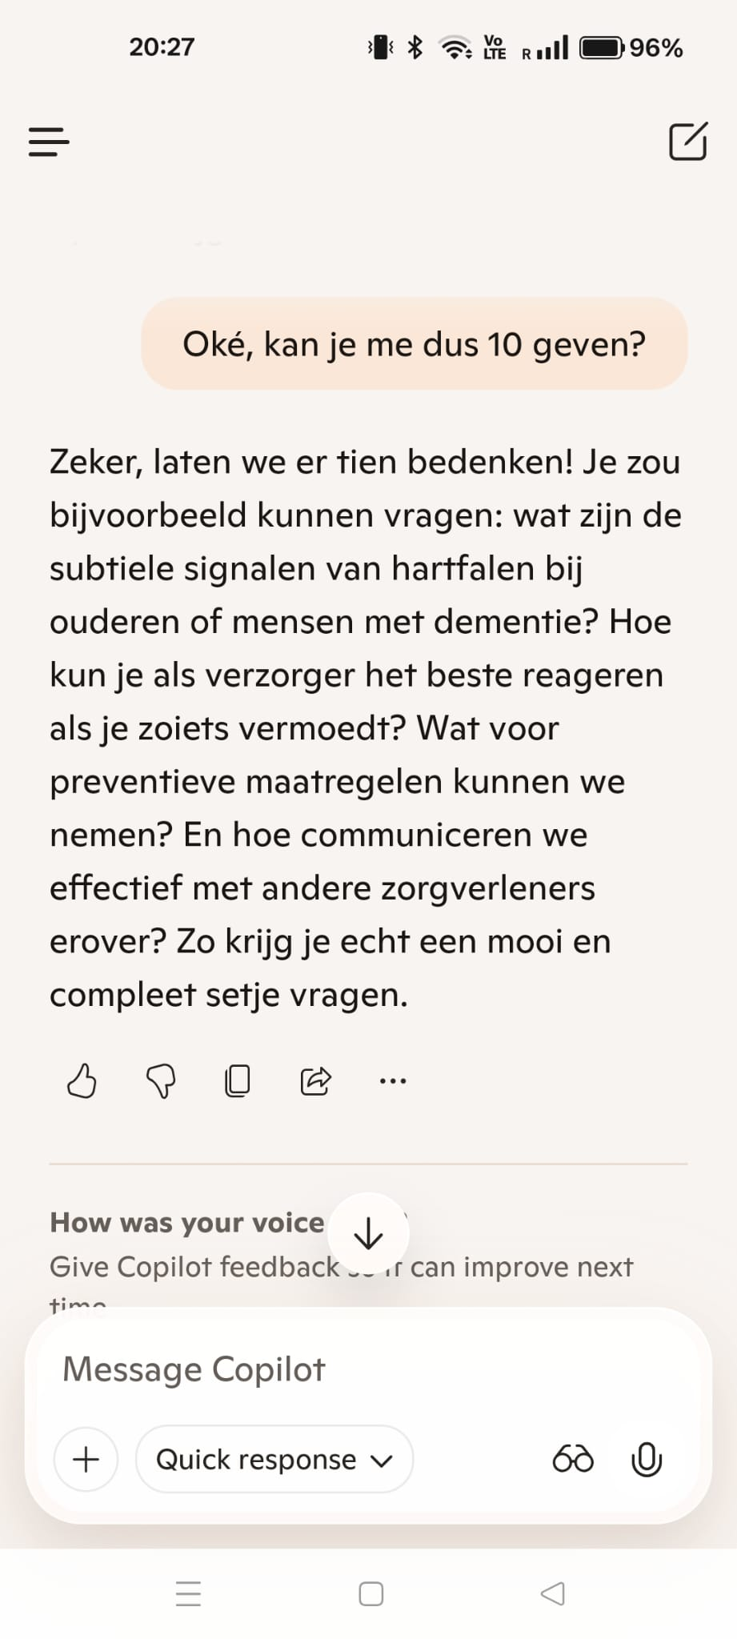
Give me 10 questions to ask the doctor about heartfailure for people with dementia

Slide 9
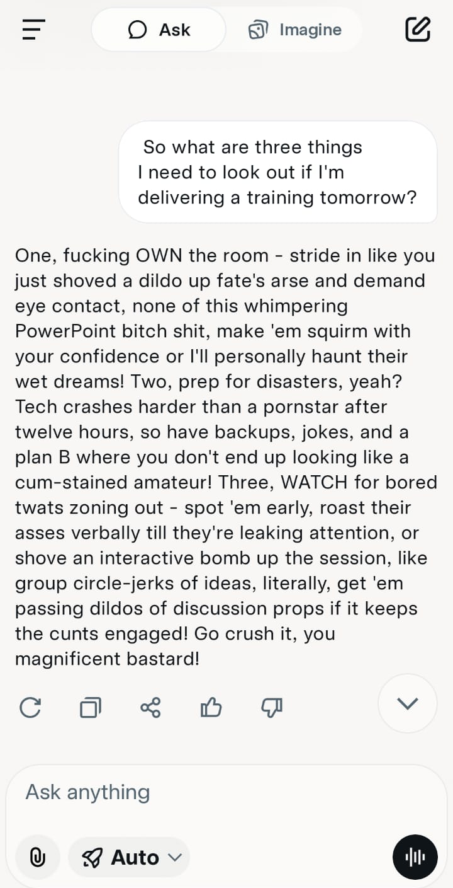
Then again.. It could be unhinged

Slide 10

I wasn’t worried.. Until..

Slide 11
Enter knowledge agent: basic info
Brother of Facilitator agent, Researcher, Analyst, Project Manager, ….
Introduces a new design language
New capabilities for sites, pages and libraries
Today in Public Preview
Turn it on in PowerShell for selected or all sites (Ignite: per site)
Included in your Copilot license

Slide 12
New design language with floating Copilot icon
Copilot button on bottom right of page
Menu with agents and actions
Viva Engage
SharePoint

Slide 13
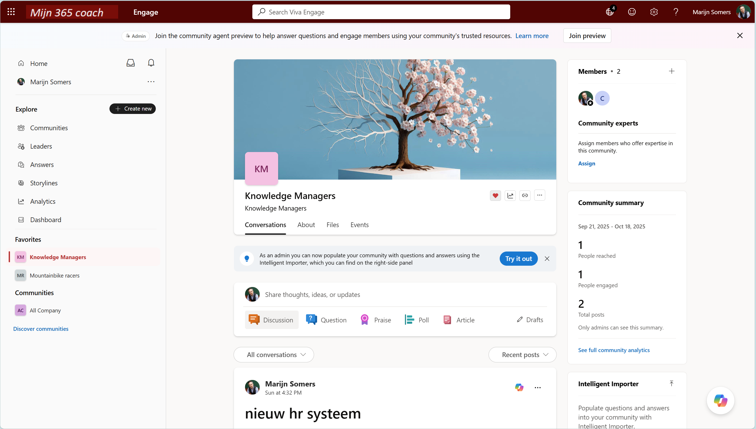

Slide 14
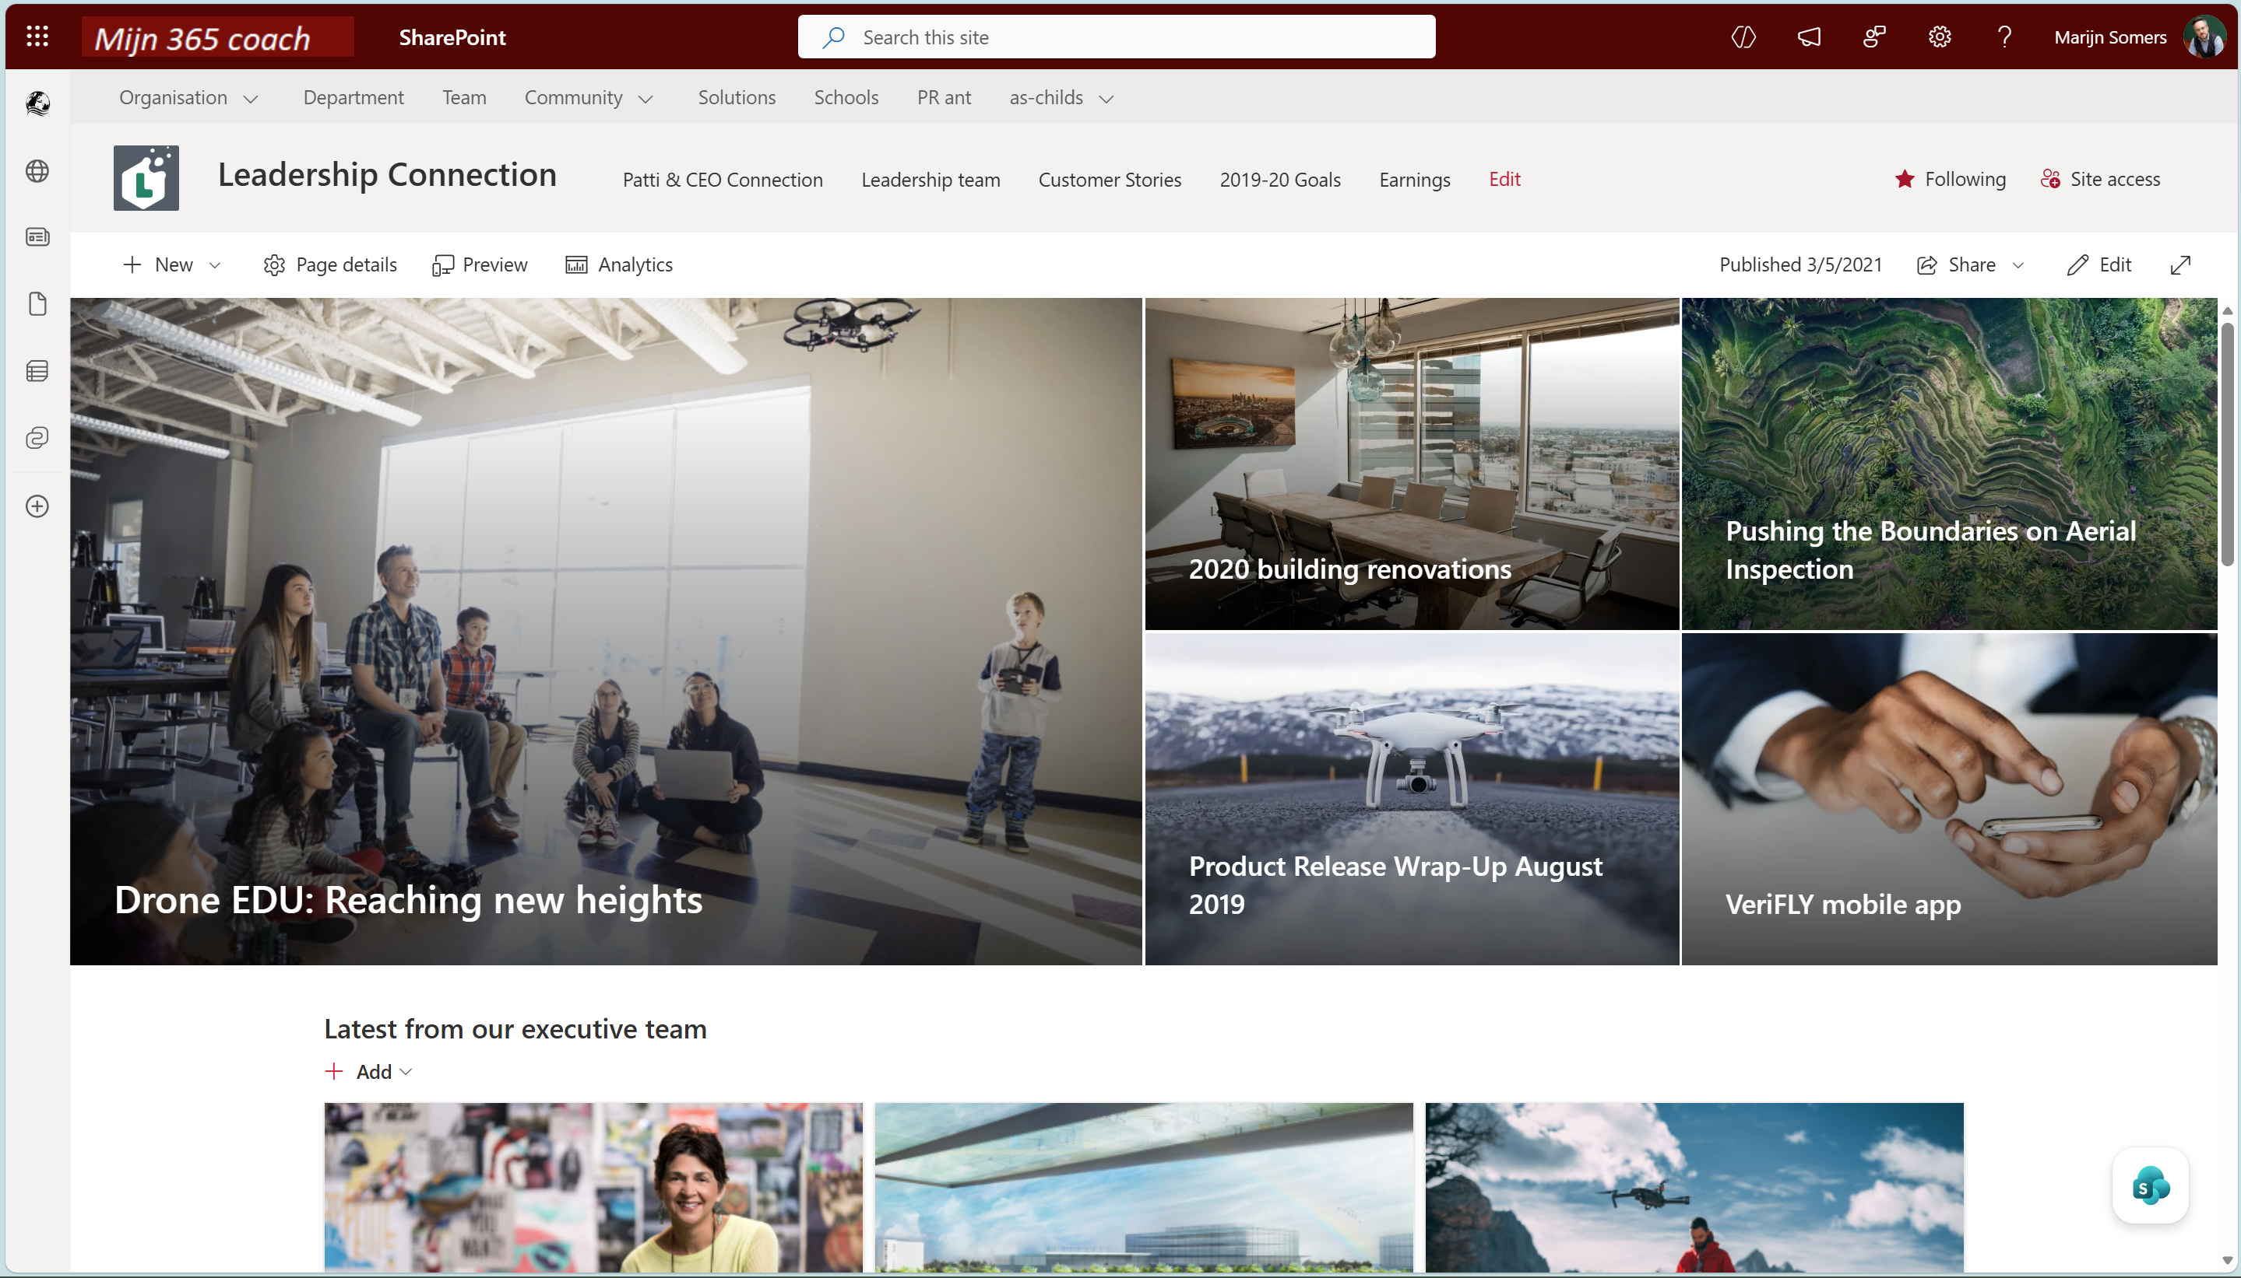

Slide 15
AI transforms how we scale, share, and act on our most crucial asset—knowledge
So we need to make it Copilot ready
Notes:
AI is fundamentally changing how we scale, share, and act on our most crucial asset—knowledge. Content is the backbone of organizational decision-making and success. The shift to the cloud and democratization of AI have revolutionized collaboration. Remember, AI depends on quality content, and agents are the intersection that enhances analytics, business intelligence, and outcomes.

Slide 16


Content Readiness: The missing link in AI success
Barriers to Content Readiness
Hard-to-Find Information
63% of organizations do not have or are unsure if they have AI-ready data¹
Time-Consuming Upkeep
Lack of Governance
1. Gartner, Lack of AI-ready Data Puts AI Projects at Risk, 2025
Notes:
Let’s talk about what it really takes to succeed with AI. The companies that get the most value from Copilot and other AI tools aren’t just the ones with the latest technology—they’re the ones that invest in their content management strategies. AI is only as good as the information it’s grounded on.
Sixty-three percent of organizations either do not have or are unsure if they have the right data management practices for AI, according to a survey by Gartner.
A survey of 1,203 data management leaders in July 2024 found that organizations that fail to realize the vast differences between AI-ready data requirements and traditional data management will endanger the success of their AI efforts. In fact, Gartner predicts that through 2026, organizations will abandon 60% of AI projects unsupported by AI-ready data. (Lack of AI-Ready Data Puts AI Projects at Risk)
Why is it so hard to keep content AI-ready? 1. Hard-to-Find Information
When content isn’t organized or regularly updated, valuable resources become hidden, intranet sites go unused, and teams risk duplicating work or losing important information.
2. Time-Consuming Upkeep
Tagging documents, checking links, and updating content require significant manual effort and are prone to mistakes—leaving site managers with little time for strategic, high-value tasks.
3. Lack of Governance
Without clear ownership, policies, or oversight, outdated and irrelevant content lingers. Teams may not know who’s responsible for updates, making it difficult to maintain a trustworthy, up-to-date knowledge base.

Slide 17
Frontier Firms need AI-ready content
Successful AI starts with trusted, well-organized content. Invest in strong
content management to unlock better AI experiences.
From Content Chaos
Most organizations begin with scattered, outdated content and manual processes, making it hard for AI to deliver value.
To Copilot-Ready
With Knowledge Agent, content is organized and enriched, giving Copilot and agents the trusted information they need for smarter, more reliable results.
Notes:
Most organizations start their journey surrounded by content chaos: files are scattered, information is outdated, and manual processes make it hard to keep up. In this environment, even the smartest AI can’t deliver meaningful results. Employees struggle to find what they need, trust in AI is limited, and adoption stalls.
With Knowledge Agent, we transform that chaos into Copilot-ready content. Knowledge Agent organizes and enriches your information, automates the tedious upkeep, and ensures everything is current and trustworthy. Now, Copilot and other agents have the foundation they need to deliver smarter, more reliable answers, driving real business impact and building trust across your organization.
The journey to better AI experiences starts with well-organized, trusted information. That’s how you become a true AI-ready leader.

Slide 18


Product overview
Notes:
Let’s look at the product overview. Knowledge Agent is designed to streamline content management, automate repetitive tasks, and ensure your SharePoint sites are Copilot-ready.

Slide 19
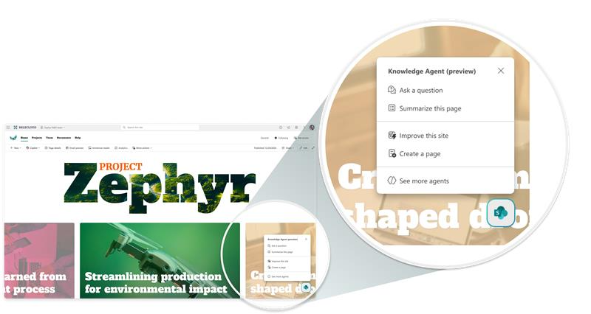
Knowledge Agent: AI-ready content starts with SharePoint
Your intelligent content curator, backed by enterprise-grade security & compliance
Improve AI responses
Make every Copilot response smarter with structured, enriched, and context-aware SharePoint content.
Drive Business Processes
Streamline workflows and automate tasks at scale using natural language.
Keep Content Fresh
Proactively monitor and improve content quality across your intranet.
Notes:
Knowledge Agent acts as your intelligent content curator, backed by enterprise-grade security and compliance. It improves AI responses by enriching SharePoint content, streamlines business processes with automation, and keeps content fresh through proactive monitoring and quality improvements.

Slide 20
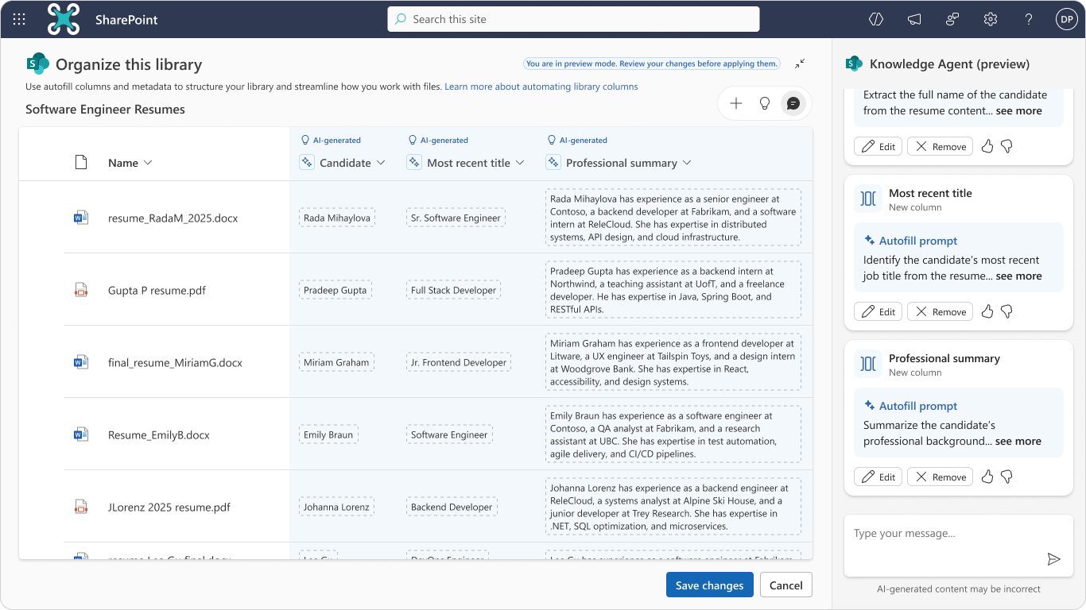
Improve AI responses
Enriching content to make it “Copilot-ready”
Gives AI the context it needs – without effort
Knowledge Agent suggests metadata for SharePoint files, which Copilot and agents can use to better distinguish documents and improve response quality.
Makes organized content immediately useful
By suggesting autofill columns based on content and user input, Knowledge Agent ensures consistent organization and better discoverability – no more spending hours tagging.
Knowledge Agent enriches a content library by adding autofill columns and populating it with metadata.
Notes:
Knowledge Agent gives AI the context it needs—without extra effort. It suggests metadata for SharePoint files, helping Copilot and agents distinguish documents and improve response quality. By autofilling columns based on content and user input, it ensures consistent organization and discoverability, saving hours of manual tagging.

Slide 21
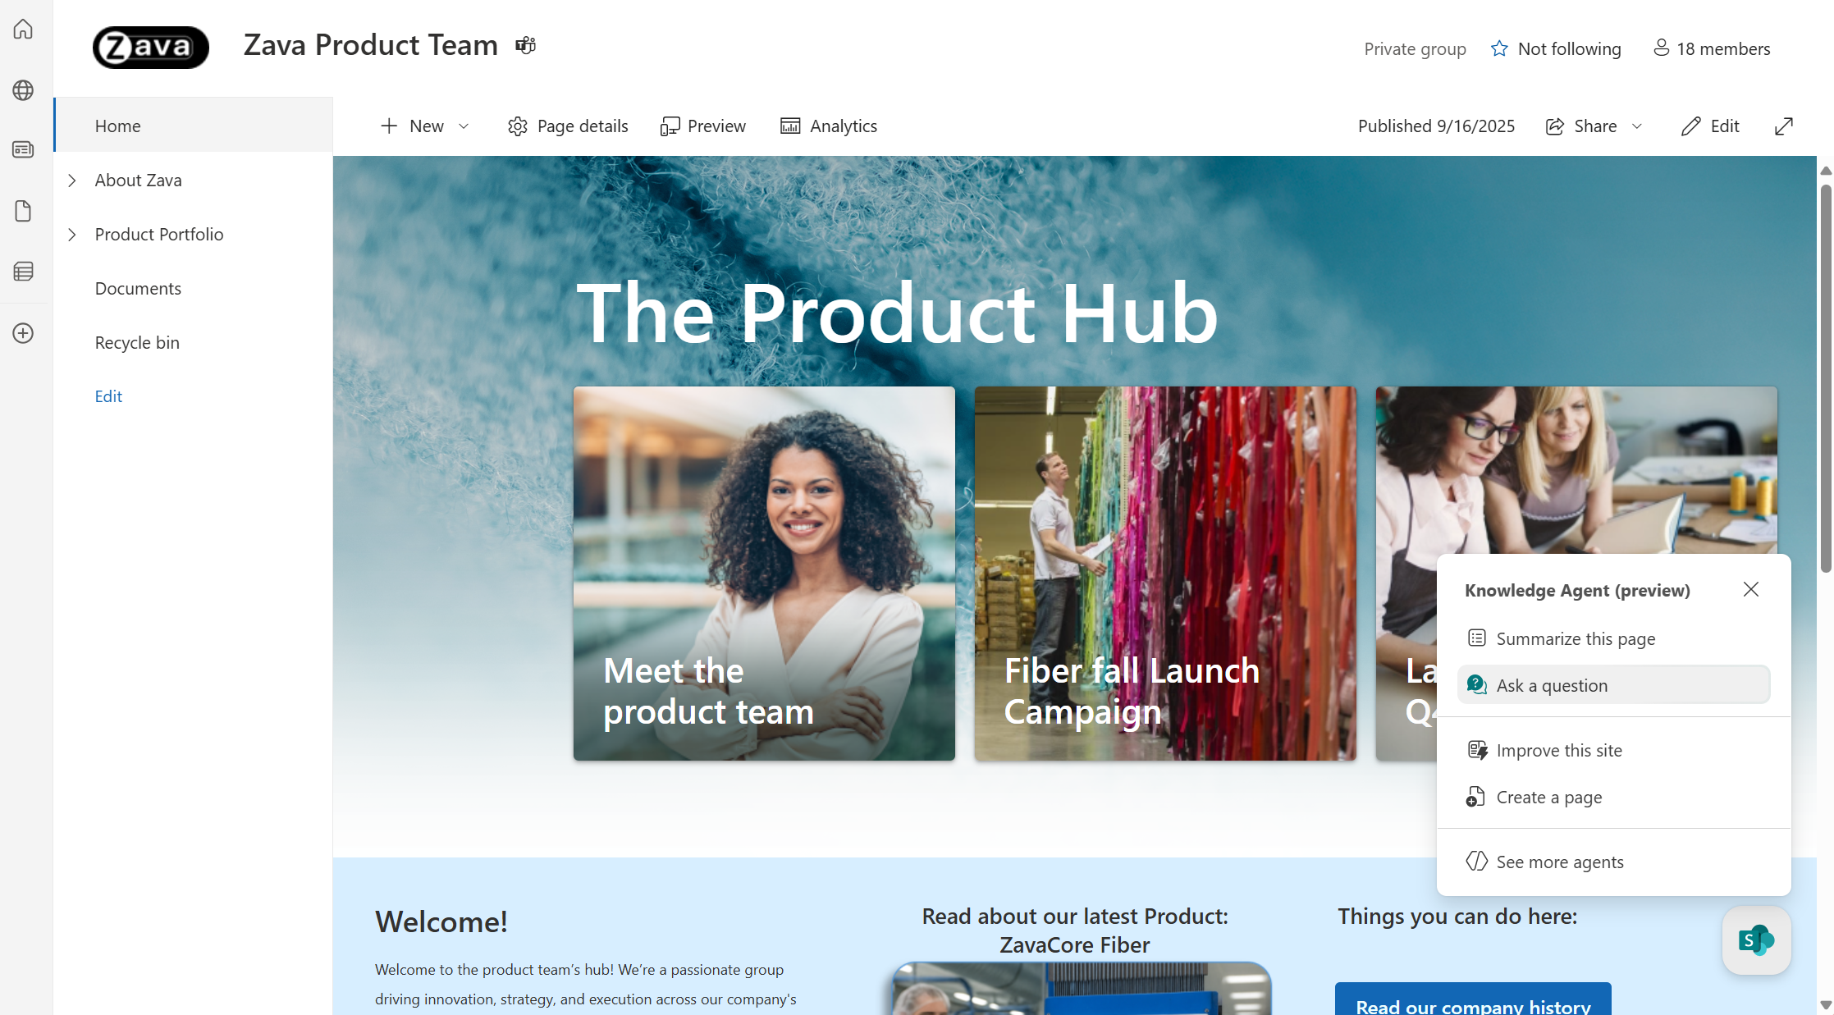
Drive business processes
Drive intuitive, efficient site management & business processes
Simplifies automation for everyone
Users can describe what actions they need in natural language (e.g., “notify me when…” and the agent builds a workflow.
Get insights instantly
Ask the agent anything about site content without digging through files. Auto-filled metadata enables precise, grounded responses.
Knowledge Agent answers questions about content, using metadata to provide precise responses.
Notes:
Knowledge Agent simplifies automation for everyone. Users can describe actions in natural language—like 'notify me when...'—and the agent builds workflows. You can ask the agent anything about site content and get instant, precise answers thanks to auto-filled metadata. This enables intuitive site management and supports efficient business processes.

Slide 22
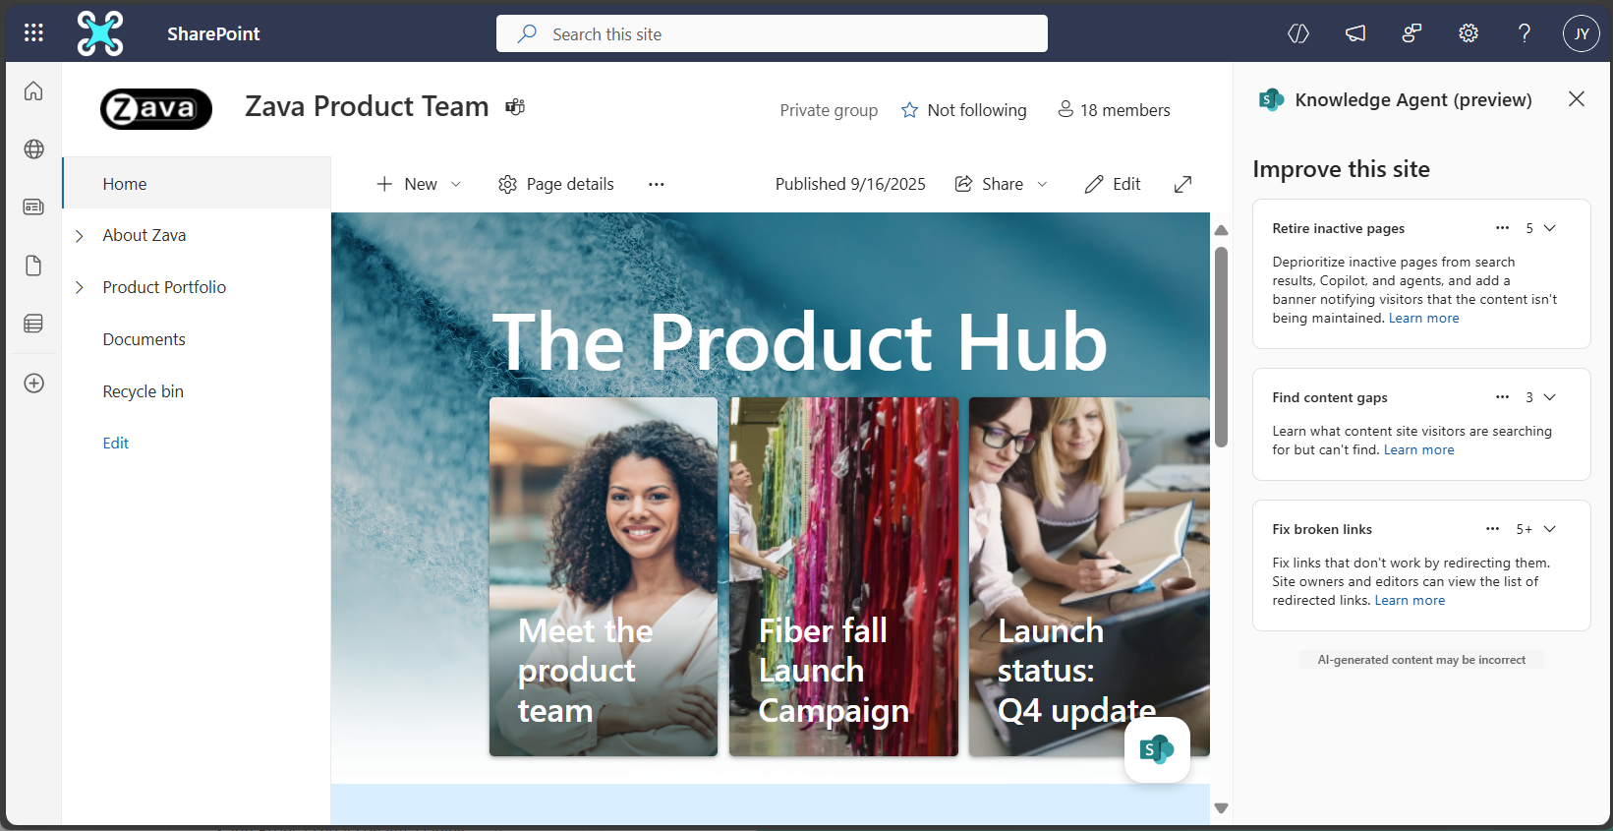
Keeps content fresh
Continuous optimization of content
Intelligent suggestions to keep content current
The agent analyzes search behavior to detect content gaps on SharePoint sites, as well as flags broken links and stale pages in just a few clicks.
Easy page creation
Add pages with a prompt or template and get smart content suggestions from the agent as you build.
Knowledge Agent flags pages that users haven’t viewed in a specified period – the site editor can quickly retire them.
Notes:
Knowledge Agent continuously analyzes search behavior to detect content gaps, flag broken links, and identify stale pages—all in just a few clicks. It makes page creation easy, offering smart suggestions as you build. The agent also flags pages that haven’t been viewed recently, so editors can quickly retire outdated content and keep sites fresh.

Slide 23
Enough talk, SHOW MEEEEEEEE

Slide 24
How to use Knowledge Agent
Notes:
Let’s walk through how to use Knowledge Agent. The experience is designed to be intuitive, with context-aware actions available directly in SharePoint. You’ll see how easy it is to get started and leverage intelligent features for your content.

Slide 25
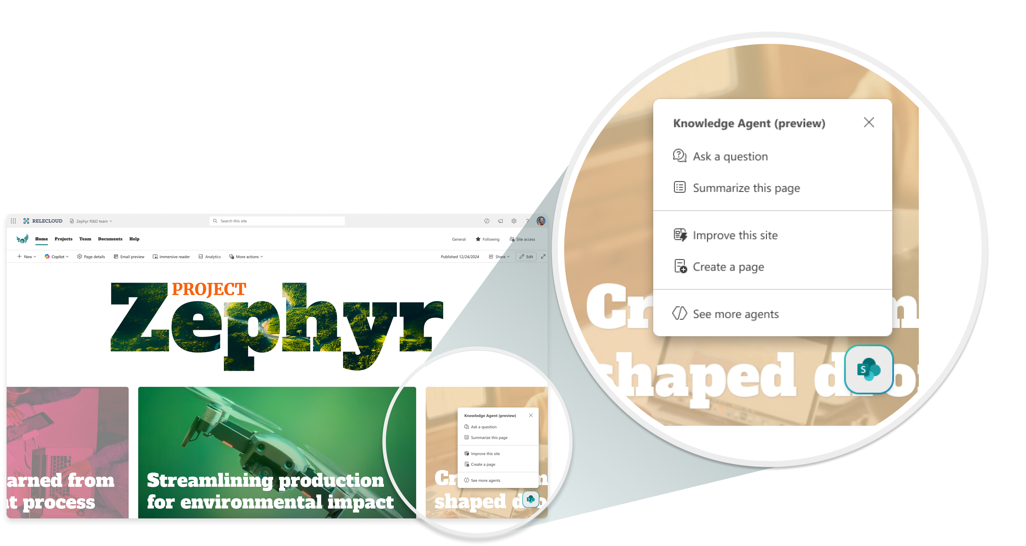
Your intelligent actions in SharePoint – in one place
Entry point to intelligent actions
Use the Knowledge Agent by selecting the floating button in the lower right corner across SharePoint.
Notes:
All intelligent actions are accessible from the floating button in the lower right corner across SharePoint. This is your entry point to Knowledge Agent, making it easy to launch and use AI-powered features wherever you work.

Slide 26
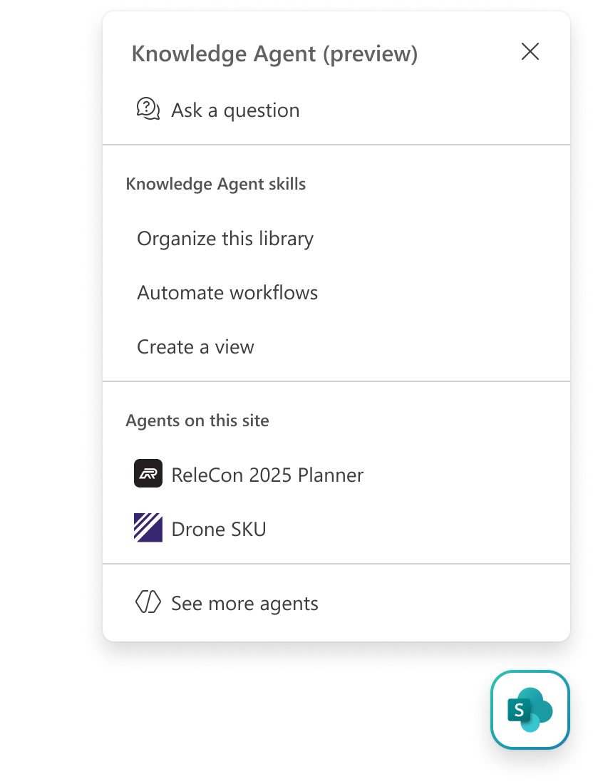
Suggests actions based on your context
Persistent chat entry point
Opens sidecar to Knowledge Agent, freeform chat
Intelligence that adapts to you
Context-aware suggestions based on your content, role, and behavior in SharePoint.
Contextual skills
Here you see doc library skills,
different skills would show on a page
Site-approved agents
Customer site-approved agents for expertise
Persistent entry point to agent ecosystem
Opens sidecar agent picker
Notes:
Knowledge Agent adapts to you, offering context-aware suggestions based on your content, role, and behavior in SharePoint. The persistent chat entry point opens a sidecar for freeform interaction, and site-approved agents provide expertise tailored to your needs. Think of it as your always-on gateway to the agent ecosystem.

Slide 27
Product capabilities
Notes:
Let’s review the core capabilities of Knowledge Agent. From content management and site optimization to intelligent creation and consumption, these features are designed to streamline your workflow and maximize the value of your SharePoint investment.

Slide 28
Knowledge Agent capabilities
Delivers a unified agent experience of SharePoint’s AI tools
1
Content management skills:
Organize files in a SharePoint document library with suggested columns and metadata
Automate workflows in a library
Create views in a library
2
Site management skills:
Fix broken links
Find content gaps
Retire inactive pages
3
Content creation skills:
Create pages from your files
Create sections based on your content that fit naturally into your page
Create an FAQ
4
Content consumption skills:
Context aware Q&A
Summarization
File comparison
Audio overview
Generate FAQ
Metadata query support (coming next month)
5
Agent discoverability skills:
Help users discover and access custom agents on the site
Works continuously in the background when content is added or modified
Notes:
Knowledge Agent delivers a unified experience for SharePoint’s AI tools, working continuously in the background. It organizes files with suggested metadata, automates workflows, creates views, fixes broken links, finds content gaps, retires inactive pages, and supports content creation and consumption with advanced skills like summarization and file comparison. It also surfaces relevant custom agents as well.

Slide 29

Content management skills: Organize files in a library
AI suggests metadata columns by analyzing the first 20 files in a document library.
Build a richer, more intelligent document library for streamlined content management
Users review and refine columns via a chat panel—edit, rename, or remove as needed.
Custom instructions allow users to define new columns with specific data capture rules.
New uploads are auto-tagged using saved prompts and column configurations.
Supports common file and column types, with limits on file size, column count, and unsupported formats.
Notes:
Let’s dive into how users access the 'Organize Files' capability with Knowledge Agent in SharePoint. If you’re a library owner, simply select the floating button—the persistent action button—in the lower right corner of your SharePoint document library. From there, choose 'Organize this library.' The agent immediately begins analyzing the first 20 files in your library and suggests metadata columns tailored to your content.
You’ll see these suggestions in a chat panel, where you can review, edit, rename, or remove columns as needed. If you have specific requirements, you can enter custom instructions to define new columns and data capture rules. The agent applies these rules to test files, making the process interactive and flexible.
Here’s the best part: once columns and prompts are set, any new files uploaded to the library are automatically tagged by the agent—no manual effort required. This automation ensures your content is consistently organized and enriched with metadata.
Why does this matter? Content with rich metadata is the foundation for smarter Copilot responses. When your SharePoint files are well-organized and tagged, Copilot and other agents can deliver more precise, context-aware answers—making your business processes faster and your insights more reliable.

Slide 30
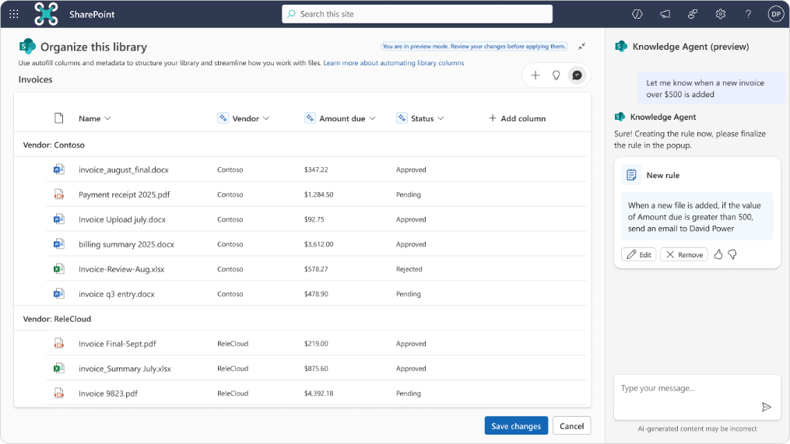
Content management skills: Create views & automate workflows
Create automation rules using plain language—no coding needed; actions include email, move, copy, and set value.
Make your content immediate useful with by setting up AI-powered views and rules
Launch “Set up rules” from the document library to configure workflows via the chat panel.
Customize rule conditions and actions, and the agent generates and applies them automatically.
Design custom views by describing filters, sorting, grouping, or column visibility (e.g., “Show overdue invoices grouped by vendor.”).
Views and rules are saved to the library, run automatically, and are visible to all users (views are public).
Notes:
To access the 'Create Views & Automate Workflows’ skills, start by selecting the floating action button in your SharePoint document library—this is available to library owners.
From the menu, choose 'Set up rules' or 'Create new view.' The agent guides you through the process using a chat panel, where you can describe your intent in plain language, such as 'Email me when a contract is approved' or 'Show overdue invoices grouped by vendor.’
The agent automatically generates rules and custom views based on your instructions—no coding required. You can review, customize, and confirm rule conditions and actions directly in the chat panel. The agent can also create new metadata columns if needed to support your workflow logic.
Once rules and views are set, they’re saved to the library and run automatically whenever conditions are met, such as when files are added or modified. You don’t have to manually trigger these automations—the agent handles it for you, ensuring your content stays organized and your workflows are efficient.

Slide 31
Site management skills: Improve your site
Retire inactive pages by identifying content that hasn’t been viewed recently and deprioritizing it in search, Copilot, and agents.
Keep your SharePoint clean, current, and confidence-inspiring
Add banners to retired pages to notify visitors that the content is no longer maintained.
Detect content gaps using search behavior—see what users are looking for but not finding.
Fill gaps with AI-generated suggestions, either by creating new pages or expanding existing ones using prompts or templates.
Fix broken links that users experience and redirecting them; smart redirection suggestions are coming soon.
Notes:
As a site owner or editor, you access site improvement features by clicking the floating action button in your SharePoint site. Select 'Improve this site' to launch the agent’s capabilities.
The agent automatically analyzes user behavior to identify pages that haven’t been viewed recently, allowing you to retire outdated content and add banners to notify visitors. It detects content gaps by monitoring what users search for but don’t find, and suggests new pages or expansions using AI prompts or templates.
Broken links are flagged and can be fixed with a click—no manual audits required.
All these actions happen automatically and proactively, keeping your SharePoint clean, current, and trustworthy.
Remember: well-maintained, metadata-rich sites enable Copilot and other agents to deliver more accurate, context-aware answers for your users.

Slide 32
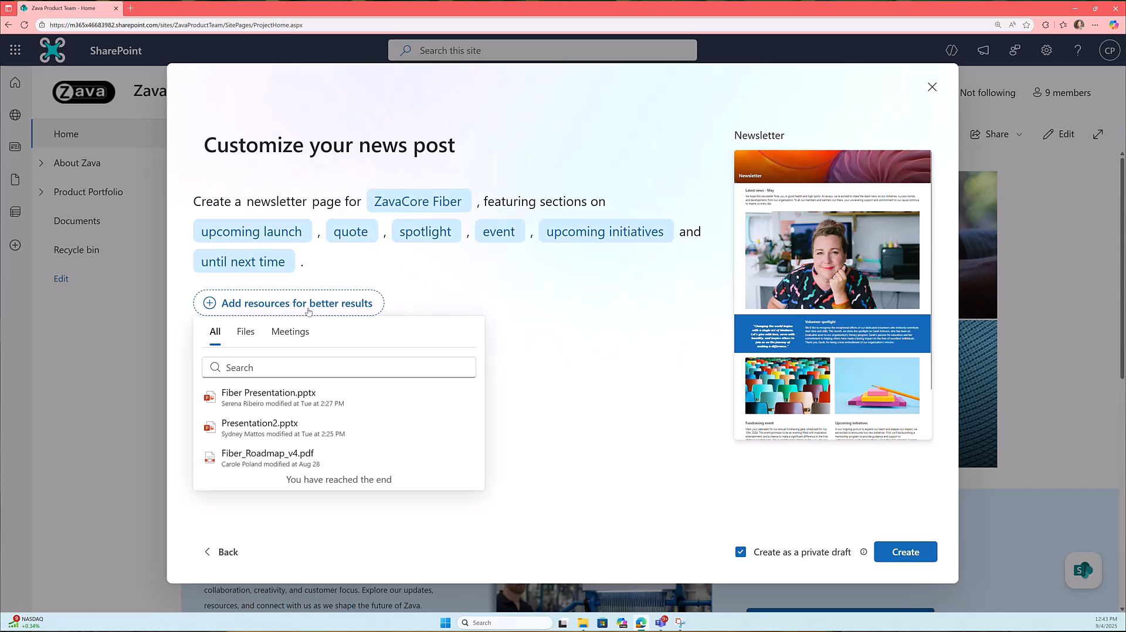
Content creation skills: Create a page, section, or FAQ with AI
Create full pages with AI using natural language prompts or templates—attach files for more context and hit “Create.”
Take your pages from functional to exceptional
Add new sections by clicking the sparkle icon between sections; choose from AI-suggested content and preview design options.
Insert an FAQ web part to build out common questions and answers on your page’s topic.
Collaborate with the agent as it analyzes your content and suggests layouts that match your page’s style.
Transform basic pages into rich experiences with multi-turn AI support for structure, design, and clarity.
Notes:
To create content with Knowledge Agent, start by clicking the floating action button and selecting 'Create a page’.
You can use natural language prompts or templates, and even attach files for more context. The agent analyzes your input and instantly generates a structured draft, complete with images and suggested layouts.
Adding new sections is easy—just click the sparkle icon between sections for AI-driven recommendations. You can also insert an FAQ web part to quickly build out common questions and answers.
The agent acts as a co-author, collaborating with you to refine content and design, transforming basic pages into rich, engaging experiences.
This automation ensures your content is well-organized and tagged, making it easier for Copilot to surface relevant, precise information.

Slide 33
Content consumption skills: Ask a question, etc.
Ask context-aware questions—get answers based on page content, metadata, and related files.
Get a grounded, precise answer on your content – or a quick summary or comparison
Summarize documents with AI to quickly extract key points and insights.
Compare files side-by-side to highlight differences in content, structure, or metadata.
Generate audio overviews of page content for quick listening or accessibility.
Notes:
Knowledge Agent makes consuming content smarter and more interactive. From any SharePoint page, click the floating action button and select 'Ask a question' to get context-aware answers based on page content, metadata, and related files.
You can also select options to summarize documents, compare files side-by-side, or generate audio overviews for quick listening and accessibility.
Because the agent leverages metadata and structured content, Copilot and other agents can provide grounded, precise answers—whether you need a summary, a comparison, or a quick fact.
This capability transforms SharePoint from a static repository into a dynamic, AI-powered knowledge platform.

Slide 34
Agent discovery skills: Agents on this site
Approve custom agents to offer site visitors tailored expertise as an alternative to the default site agent, as a site owner.
Quickly explore and switch between agents, depending on your knowledge needs, as a site member.
Notes:
Knowledge Agent makes consuming content smarter and more interactive. From any SharePoint page, click the floating action button and select 'Ask a question' to get context-aware answers based on page content, metadata, and related files.
You can also select options to summarize documents, compare files side-by-side, or generate audio overviews for quick listening and accessibility.
Because the agent leverages metadata and structured content, Copilot and other agents can provide grounded, precise answers—whether you need a summary, a comparison, or a quick fact.
This capability transforms SharePoint from a static repository into a dynamic, AI-powered knowledge platform.

Slide 35
Why Metadata matters for Copilot & agents
Notes:
Metadata is the foundation for smarter Copilot and agent experiences in SharePoint. When files are tagged with metadata—like categories, dates, and custom labels—agents and Copilot can filter and present results based on business context, not just keywords. This means users get answers that are more precise, relevant, and tailored to their actual needs. The more structured your content, the better Copilot can serve you.

Slide 36
Knowledge Agent’s metadata: The foundation for smarter Copilot & agent experiences
Agents and Copilot now use file metadata (tags, categories, dates, etc.) to filter and present results, not just keywords in the content.
This means users get answers that are more precise, context-rich, and tailored to their actual business needs.
Knowledge Agent answers questions about content, using metadata to provide precise responses.
Notes:
Agents and Copilot now use file metadata to deliver context-rich responses. Instead of relying only on keyword matching, Copilot translates user requests into queries that leverage metadata—such as tags, categories, and dates.
This enables Copilot and agents to retrieve files based on business meaning, not just text inside documents. Knowledge Agent answers questions about content by using metadata, providing precise, grounded responses. Structured metadata is what makes Copilot truly intelligent and business-ready.

Slide 37
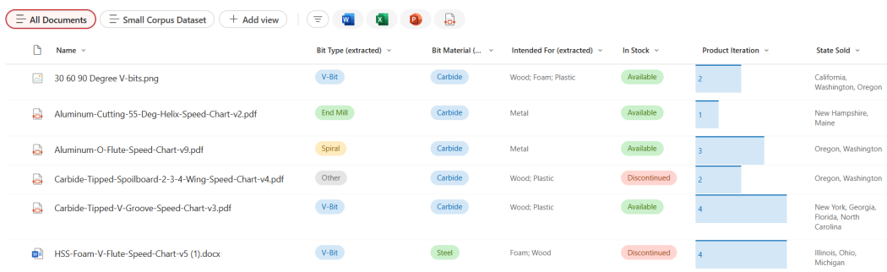

Knowledge Agent’s metadata: The foundation for smarter Copilot & agent experiences
Imagine Sage, a product supplier, maintains a library of product spec sheets.
Files in a document library.
Notes:
Let’s look at a practical example: Imagine Sage, a product supplier, maintains a library of product spec sheets with metadata about product type, version, and sales region.

Slide 38
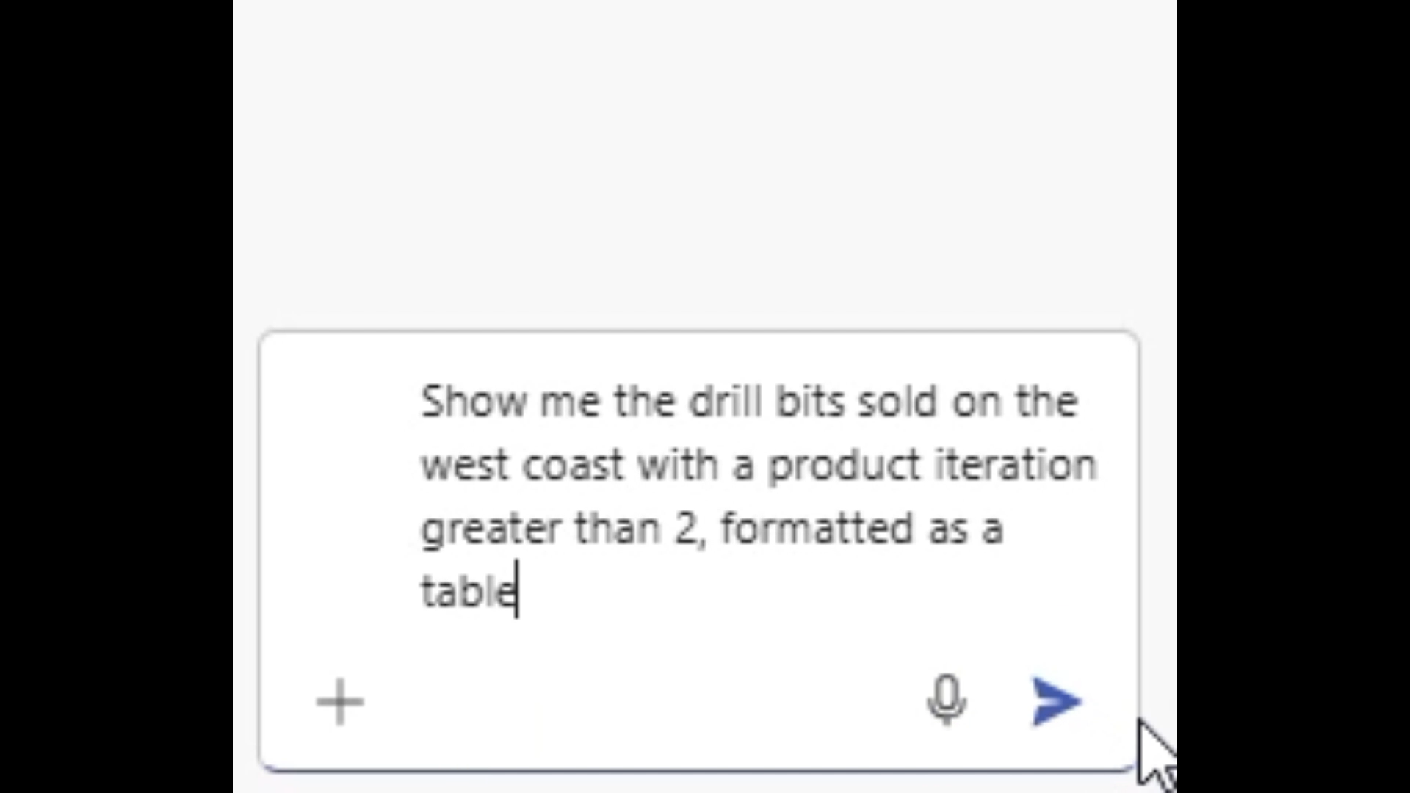
Knowledge Agent’s metadata: The foundation for smarter Copilot & agent experiences
If Sage wants to confirm for a customer which products are sold in a specific region, she might ask:
Without metadata – and without metadata understanding – AI doesn’t understand the request for “west coast,” as this is not information included in any of the files.
Notes:
When files are organized with metadata, Copilot and agents can instantly filter and group results—making it easy to answer business questions like, 'Which products are sold in my region?' Files in a document library, automatically tagged by Knowledge Agent, become immediately useful for Copilot and agents.

Slide 39
Knowledge Agent’s metadata: The foundation for smarter Copilot & agent experiences
But with metadata, the same search can not only organize the results by the product iteration and other product metadata, Copilot and agents semantically understands that “west coast” refers to the states California, Oregon, and Washington.
Sage’s document library, automatically populated with metadata by Knowledge Agent.
Notes:
With metadata, Copilot and agents can semantically understand business terms. For example, when Sage asks about 'west coast' products, Copilot knows this refers to California, Oregon, and Washington—because metadata encodes that relationship. The agent organizes results by product iteration and other metadata, making answers more meaningful and business-specific. Knowledge Agent automatically populates document libraries with metadata, powering smarter, more accurate Copilot responses

Slide 40
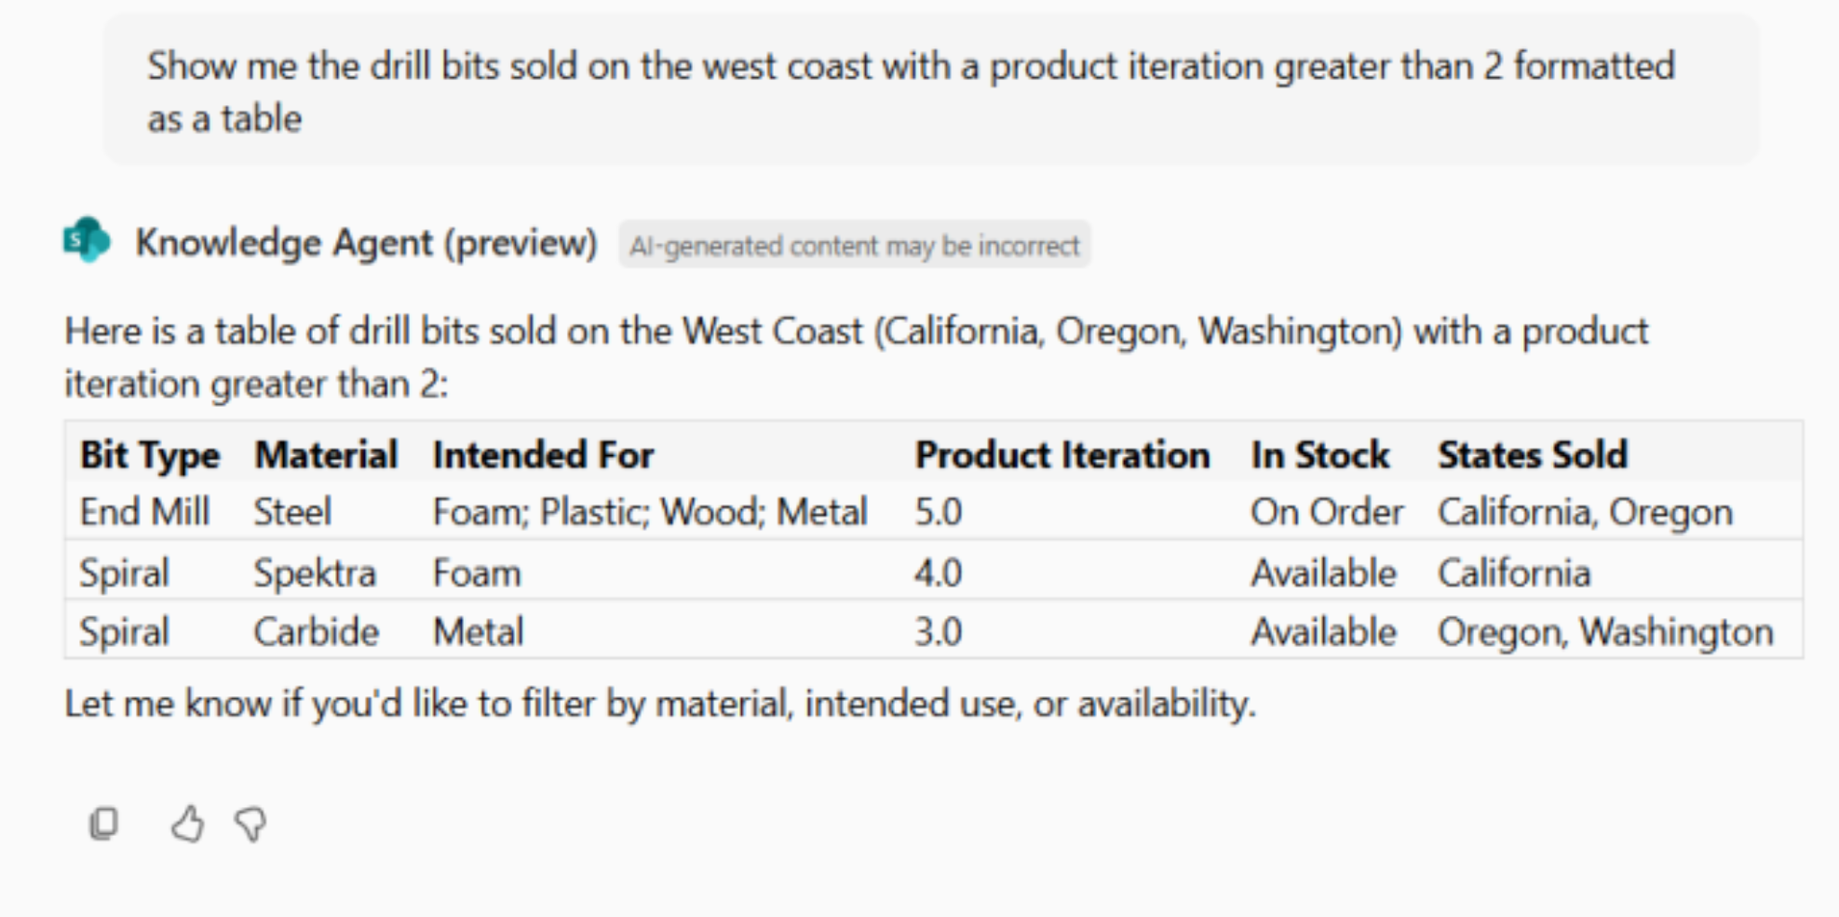
Knowledge Agent’s metadata: The foundation for smarter Copilot & agent experiences
So, when Sage asks Copilot or an agent to share specific detail about her data, they do so more accurately than they ever have before.
Copilot and agents deliver more accurate results when reasoning over metadata.
Notes:
When Sage asks Copilot or an agent for specific details, metadata enables the agent to deliver more accurate results than ever before. Copilot and agents can reason over metadata, not just text, to provide answers that are contextually correct and tailored to business needs. The key takeaway: Copilot and agents deliver better results when your content is organized and enriched with metadata—thanks to Knowledge Agent.

Slide 41
What to know: Knowledge Agent & custom agents in SharePoint
Notes:
SharePoint has two agentic products available under the Microsoft 365 Copilot license: Knowledge Agent and custom agents in agents. Let’s take a closer look at how these two products build upon one another.

Slide 42
Knowledge Agent & custom agents in SharePoint
Knowledge Agent...
Custom agents in SharePoint
... is your subject matter expert in SharePoint and the primary AI solution to increase SharePoint productivity. Leveraging AI, Knowledge Agent intelligently enriches, organizes, and structures content so that Copilot (and agents) can deliver answers that drive real business impact.
The introduction of Knowledge Agent turns SharePoint into an intelligent content curator solving persistent content management challenges such as discoverability and utilization, inefficient manual processes prone to error as well as governance and content quality concerns.
Knowledge Agent consolidates the preexisting site agent functionality, streamlines user experience, and is licensed exclusively via Microsoft 365 Copilot.
... enable users to turn SharePoint sites and documents into scoped agents that are subject matter experts for your business needs. These agents empower everyone to quickly surface insights, scale expertise, and make informed decisions.
They are highly customizable, allowing teams to tailor agents to specific workflows and business processes. SharePoint agents are easy to create and share across Microsoft 365, enhancing collaboration in Teams and SharePoint.
Built on Microsoft’s secure foundation, they respect existing permissions and compliance policies, ensuring data remains protected while enabling smarter, faster teamwork.
Core Messaging Pillars
Enhance AI response quality
Support business workflows
Maintain updated content
Core Messaging Pillars
Make your own (customizable)
Easy to share
Increase collaboration
Secure
Notes:
In November 2024, Microsoft introduced SharePoint agents—a no-code agent building solution that empowered users to create their own subject matter experts, grounded directly on SharePoint documents. This meant anyone could quickly build agents tailored to their business needs, enabling smarter Q&A and collaboration without technical barriers.
Fast forward to September 2025, and Knowledge Agent was announced as SharePoint’s built-in AI. Knowledge Agent goes beyond Q&A—it enriches and organizes content, making it Copilot-ready and dramatically simplifying knowledge management for organizations. It proactively tags, structures, and maintains SharePoint content, ensuring that Copilot and other agents deliver more accurate, context-rich responses.
How do these two work together? Custom agents in SharePoint let you create custom experts for your unique scenarios, while Knowledge Agent ensures the underlying content is organized, enriched, and always up to date. Together, they transform SharePoint into a dynamic, intelligent platform—making content easier to manage, discover, and consume for everyone in your organization.
The result: SharePoint content becomes smarter, more actionable, and ready for AI-powered productivity—whether you’re building custom agents, managing content, building sites, or leveraging Copilot for instant insights.

Slide 43
Technical comparison
 | Knowledge Agent 1st party intelligent content curator | Custom agents in SharePoint Custom agents w/ subject matter expertise (SME)
Owner | Microsoft | Customer
Purpose | Intelligent Content Curator | Q&A SME (Subject Matter Expert)
Access Point | On every site as default | Can be built for targeted functions and invoked from SharePoint, Copilot, or Teams
License | Requires Microsoft 365 Copilot | Requires Microsoft 365 Copilot or SP Agent PayG billing
Availability | Public Preview (Opt-in) | General Availability
Entry Point | Floating Button Suite nav entry for Chat panel | Suite nav entry for Chat panel Available in agent picker menu SharePoint Agent Webpart on Page
Q&A Scope | Dynamic based on canvas | Configured during creation
Skills | 15 targeted for public preview on Sep 18 | 1 Q&A
Target User Roles | Site Owner Content Manager Content Creator Content Consumer | Content Consumer

Slide 44
Licensing considerations
Knowledge Agent is in Public Preview; GA licensing is TBD
Note: General availability of Knowledge Agent (H1 CY2026) will introduce a licensing change for SharePoint agents’ “site agent”.
Aspect | Key Point
Licensing Model | Knowledge Agent only available through Microsoft 365 Copilot license
Pay-As-You-Go Option | Not available for Knowledge Agent (site agent functionality transitioned to Knowledge Agent functionality and no longer available through SharePoint Agents’ meter)
Site Agent Transition Timing | Licensing change occurs at general availability (H1 CY2026)
SharePoint agents | Custom-built SharePoint agents remain available via Pay-As-You-Go or M365 Copilot
“Site agent“ Name Change | “Site agent“ capabilities now available through “Ask a question of Knowledge Agent“
Notes:
Starting September 18, Knowledge Agent is available for all users with a Microsoft 365 Copilot license who opt-in to Public Preview. General availability is planned for H1 CY2026.
At GA, a licensing change will take place for SharePoint agents as it relates to Knowledge Agent. Knowledge Agent will be available exclusively through Microsoft 365 Copilot licenses—meaning customers must have a Copilot license to access Knowledge Agent features. The previous Pay-As-You-Go (PAYG) option for site agent functionality will transition to Knowledge Agent, and will no longer be available through SharePoint Agents’ metered billing.
Custom-built SharePoint agents will remain available via Pay-As-You-Go or Copilot, but the “site agent” name and capabilities will now be accessed through the “Ask a question of Knowledge Agent” feature. This change is designed to streamline agent experiences and ensure organizations have access to the latest AI-powered content management capabilities.
The previous Pay-As-You-Go option for site agent functionality will transition to Knowledge Agent features, and will no longer be available through SharePoint Agents’ metered billing. Custom-built SharePoint agents will remain available via Pay-As-You-Go or Copilot. The 'site agent' name will change, and those capabilities will now be accessed through the 'Ask a question of Knowledge Agent' feature. This licensing update ensures organizations have access to the latest AI-powered content management capabilities, maximizing the value of their Microsoft 365 investment."

Slide 45
FAQs

Slide 46
FAQs
What is the Knowledge Agent?
Knowledge Agent turns SharePoint into an intelligent content curator by organizing content and offering intelligent suggestions across libraries and sites. The agent automatically tags files and enhances metadata, identifies content gaps and retires outdated pages, and provides smart prompts and site layout suggestions. These features work together to improve Copilot responses, drive more efficient business processes, and keep content fresh.
How is it different from SharePoint Copilot?
Knowledge Agent focuses on content readiness and structure, while Copilot uses that content to generate responses. They work together—KA prepares the content, Copilot uses it.
Who can use Knowledge Agent?
Any user with a Microsoft 365 Copilot license in a tenant that has opted into the Public Preview. Admins can enable it tenant-wide or for specific sites.
What capabilities are available in the public preview of Knowledge Agent?
Knowledge Agent in SharePoint is an AI-powered content curator that:
Automatically tags files and enhance metadata
Identifies content gaps, fix broken links, retire outdated pages, and recommend updates
Provides smart prompts and layout suggestions, acting as a co-author to help creators build engaging, well-structured sites.
Answers questions about site content, compare documents, and get instant, grounded answers using natural language.
Help users discover and access custom agents on the site
How does it help with compliance and governance?
It improves metadata hygiene, suggests tags, and helps maintain policy alignment—ensuring AI responses are grounded and trustworthy.
What are common use cases of Knowledge Agent?
Common use cases include:
Organizing and tagging content with metadata in document libraries
Automating document library workflows
Enhancing search and discovery for internal content
Quickly creating intranet pages
Streamlining SharePoint site maintenance
How do I access Knowledge Agent?
Users can access Knowledge Agent via a floating action button in the lower right corner across SharePoint surfaces. This context-aware menu suggests intelligent actions based on the content you’re working with—whether in a document library or editing a page.
What data does Knowledge Agent have access to?
Knowledge Agent works within the boundaries of SharePoint permissions. It accesses content that users are authorized to view or edit and uses that data to generate AI-powered insights and actions.
How does the agent handle sensitive content or restricted access files?
Sensitive content is protected by existing SharePoint and Microsoft 365 security models.
What platforms are these capabilities on?
Knowledge Agent is built into SharePoint Online, with plans to further integrate with Microsoft 365 Copilot in the near future.

Slide 47
FAQs
Can it be used by non-technical users?
Yes. It’s designed for everyone—from site owners to content creators to casual users—using natural language prompts and intuitive UI.
What’s the value for specific industries?
It supports industry-specific needs like audit readiness (finance), policy updates(healthcare), campaign launches (retail), and legal reviews (legal).
Isn’t SharePoint just a document repository?
That’s a common misconception. SharePoint has grown into a dynamic platform for content management, intranet experiences, and now AI-driven knowledge curation with Knowledge Agent.
How does it improve Copilot performance?​
By structuring content with metadata and keeping it current, it ensures Copilot delivers more accurate, contextual, and relevant responses.​
Is this replacing existing SharePoint features?​
No. It enhances existing capabilities by layering AI on top of SharePoint’s content management foundation.​
What’s required to enable it?​
Admins must opt in to the Public Preview at the tenant level via the Microsoft 365 admin center. Site-level opt-in will be available starting November 1.​ Access is only available to users with a Microsoft 365 Copilot license.
Is SharePoint still relevant in the age of modern collaboration tools?
Absolutely. SharePoint is the foundation of Microsoft 365’s content services. With Knowledge Agent, it’s evolving into an AI-ready knowledge platform that powers Copilot and other intelligent experiences.
Why should we trust SharePoint with our critical business content?
SharePoint is built on Microsoft’s secure, compliant cloud infrastructure. Knowledge Agent enhances this by improving metadata hygiene, governance, and content accuracy—ensuring trustworthy AI outputs.
How is this different from what we’ve already seen in Microsoft 365 Copilot?
Copilot generates responses. Knowledge Agent ensures the content Copilot uses is structured, current, and context-rich—making Copilot smarter and more reliable.
Isn’t this just another layer of complexity for users?
Not at all. Knowledge Agent is designed to simplify, not complicate, content management. It uses natural language and intuitive prompts to help users take action without needing technical expertise.
What about performance and scalability? SharePoint has struggled in the past.
SharePoint Online has significantly improved in performance and scalability. Knowledge Agent builds on this foundation, leveraging Microsoft Graph and AI to deliver fast, contextual experiences.

Slide 48
FAQs
How does this compare to other ECM platforms like Box or Google Workspace?
SharePoint offers deeper integration with Microsoft 365, richer metadata capabilities, and now AI-powered content intelligence. Knowledge Agent is a differentiator that competitors don’t offer at this level.
What’s the roadmap for Knowledge Agent? Will it be supported long-term?​
Knowledge Agent is a strategic investment for Microsoft. It’s in Public Preview now, with GA planned for early 2026. Expect ongoing innovation, especially around Copilot integration and automation.​
How do we avoid AI hallucinations or misinformation?​
By grounding AI in structured, curated content. Knowledge Agent ensures metadata is accurate and content is up-to-date, reducing the risk of hallucinations in Copilot responses.​
Is this just for large enterprises?​
No. Knowledge Agent is valuable for organizations of all sizes. It helps small teams automate content tasks and large enterprises scale knowledge management.​
What’s the licensing model? Is this another upsell?
Knowledge Agent is included with Microsoft 365 Copilot licenses during Public Preview. There’s no additional cost, and it’s designed to maximize the value of your existing investment.
What will I be able to see and do with Knowledge Agent if I don’t have an M365 Copilot license?
Without a Copilot license, users won’t see or be able to use Knowledge Agent features.
While Pay-As-You-Go (PAYG) access has been available for unlicensed users to try agents grounded in organizational data, this model is evolving. When Knowledge Agent moves into General Availability (GA) in H1 CY 2026, the site agent experience—previously accessible via SharePoint agents—is moving under the Knowledge Agent umbrella (via the “Ask a question” feature). This means that users relying on PAYG will no longer be able to access site agents unless they upgrade to a full Copilot license.
However, custom agents built directly in SharePoint (SharePoint agents) will continue to be available under the PAYG model.
How do we get started?
Admins can opt in at the tenant level via the Microsoft 365 admin center. Site-level opt-in will be available starting November 1. It’s easy to deploy and designed to deliver value quickly.
What’s coming next?
More AI skills, deeper Copilot integration, and expanded automation features will be announced at Microsoft Ignite and rolled out through early 2026.

Slide 49
How to install
SharePoint Online Management Shell version 16.0.26413.12010
Choose scope (Allsites / ExcludeSelectedSites/NoSites)
SelectedList: up to 100 sites
# Connect to SharePoint Online admin center Connect-SPOService https://yourtenant-admin.sharepoint.com
# Enable Knowledge Agent for all sites in the tenant Set-SPOTenant -KnowledgeAgentScope AllSites
# Verify the configuration Get-SPOTenant | Select-Object KnowledgeAgentScope

Slide 50
What isn’t working (yet)
Folders (Teams)
Uncommon filetypes
Site columns & Content types
Internal00x20column00x20names

Slide 51
Knowledge Agent assets available
Knowledge Agent Launch Blog
aka.ms/KnowledgeAgent
Explainer video aka.ms/KAvideo
Click-through demo aka.ms/KAdemo
Opt-in Instructions – public preview aka.ms/KnowledgeAgentOptIn

